Slide 1
Verification-First Clinical Engineering
A Zero-Trust Pipeline for Deployment-Ready MOH Guidelines
Notes:
Visual Idea: A split screen. On the left, a dusty PDF manual. On the right, a sleek mobile phone running ODK. In the middle, a shield icon representing "Verificati

Slide 2
Current digitization is a manual, error-prone translation task
The Status Quo: Developers interview MDs or interpret Ministry of Health (MOH) PDFs to write code (CHT, ODK, OpenSRP).
The Risk: "Trust-based" transcription introduces silent errors:
Missed exclusion criteria (e.g., age cutoffs).
Unsafe defaults (e.g., treating missing temperature as "normal").
Logic gaps (e.g., stockout scenarios ignored).
Code takes years to write! So few CHWs have clinical support on their phones
Notes:
Visual Idea: A flowchart showing "PDF $\rightarrow$ Human Dev $\rightarrow$ Code" with red warning icons at the "Human Dev" stage labeled "Subjective Interpretation."

Slide 3
The Solution: Zero-Trust Engineering
Core Philosophy: "Zero-Trust." We assume every artifact is flawed until proven otherwise
The Verification Stack:
Adversarial Extraction: "Red Teams" hunting for logic gaps at each step of creating the clinical logic and code
Formal Verification: Mathematical proofs of desirable properties: no infinite loops, decision trees have graceful endpoints, etc.
Human Sovereignty: Mandatory sign-offs of clinical logic & of translations
Traceability: Cryptographic links to source text
Differential Testing: Synthetic patient simulations show approved clinical logic operates the same as the final code
Notes:
Visual Idea: A layer-cake diagram showing the 6 layers stacked up, supporting a "Deployment Ready" flag at the top

Slide 4
The Solution: Zero-Trust Engineering
Core Philosophy: "Zero-Trust." We assume every artifact is flawed until proven otherwise
The Verification Stack:
Adversarial Extraction: "Red Teams" hunting for logic gaps at each step of creating the clinical logic and code
Formal Verification: Mathematical proofs of desirable properties: no infinite loops, decision trees have graceful endpoints, etc.
Human Sovereignty: Mandatory sign-offs of clinical logic & of translations
Traceability: Cryptographic links to source text
Differential Testing: Synthetic patient simulations show approved clinical logic operates the same as the final code
Notes:
Visual Idea: A layer-cake diagram showing the 6 layers stacked up, supporting a "Deployment Ready" flag at the top

Slide 5
Validating our approach
Evidence
Independent Oracles: Validation against external ground truths.

Slide 6
Adversarial Logic Extraction
Replacing "Single-Pass Coding" with "Red Teaming"
Multi-Pipeline: We run two independent AI pipelines from guideline to decision table.
Adversarial Agents: A specialized "Red Team" AI attacks each step, hunting for "silent killers":
What if they are out of the treatment?
Does this rule contradict Page 42?
Are terms unclear?
Consensus Gate: No code generation unless both pipelines exhibit behavioral equivalence
Notes:
Visual Idea: Two parallel arrows (Pipeline A & Pipeline B) converging at a "Consensus Check," with a "Red Team" bot attacking both arrows.

Slide 7
Pipeline of LLM prompts
Determine supplies and equipment
Determine local environmental shifters: Rural, “Malaria nearby,” stockout of malaria rapid test, etc.
Divide the manual into specific facts and “species” of fact: Determine order of modules (cough, fever, etc); determine when to do a test or ask a questions; clinically relevant cutpoints, decision rules; integrative issues (drug interactions, etc).
Look for “rough edges” in the manual and wait for MOH clarifications

Slide 8
Digesting a manual
Create a list of facts
Create a table of symbols (facts, tests, diagnoses, treatments, etc.)
Building off of WHO’s crisis care digital adaptation kit, whose dictionary has most of the relevant terms (along with FHIR-compliant codes for drugs, diagnoses, etc.)
Turn all continuous variables into Boolean variables used in decisions.
Create rules for when modules get added to the queue and the order of execution in the queue (including possibly skipping the queue for emergency referrals.
Create the clinical decision logic for each module

Slide 9
SCHEMAS
Markdown format to describe the pipeline from PDF manual to DMN and then XLSForm
DMN: What subset of logic
Patient data
Medical record = log file
Snippet of text and source and hash
Symbols table = Dictionary mapping concepts and definitions &
Phrase bank which translates "malaria" into Hindi or Swahili
Keywords like "malaria" or "temp_C" or "high_fever" ex.temp = exam to take temperature or dx.malaria
Predicate tableturns ontinuous and categorical data into true/false: if temp_C > 37.5 then has_fever = true , if muac=red then muac_red= true

Slide 10
MOH approval of the clinical logic
Turn the clinical logic into artifacts for clinicians to review
A brief narrative
a decision table
A flowchart
Wait for MOH clinical approval

Slide 11
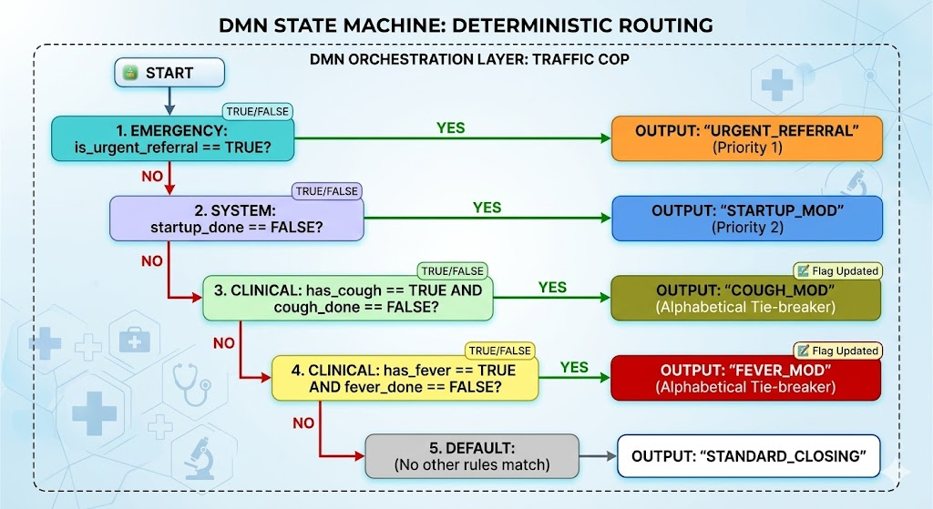
Flowchart of the traffic cop: Output = next module
Note: Runs after every module, priority order

Slide 12
Traffic cop fragment, priority order
 | Start | has_fever & not fever_mod_done | has_cough & not cough_mod_done | urgent_referral | OUTPUT (that is, next module to run)
Urgent | - | - | - | True | Urgent referral (priority = 1)
At start | True | - | - | - | Opening_mod (priority = 2)
Fever | - | True | - | - | Fever_mod (priority = 4. Fever is lower priority than cough_mod solely because the tie-breaker: Fever is later alphabetically)
Cough | - | - | True | - | Cough_mod (priority = 3)
Closing | - | - | - | - | Closing_mod (priority = 5. Because the closing module is the lowest priority, it only runs when the queue is empty)
Notes:
Priority is metadata for each output. The AIs set priority, probably just before they write the DMN tables. Decision tables shown to MDs must show priority for each option.
Any module can set has_fever, has_cough, etc. to True.
The last thing module X does is set X_mod_done =True; e.g the fever module sets fever_mod_done = True.

Slide 13
The rhythm of a patient
Queue starts with
Set at_start = True
Traffic cop picks the next module in priority order
Emergency referral (if present) has highest priority
Until traffic cop has no more modules to do & ends

Slide 14
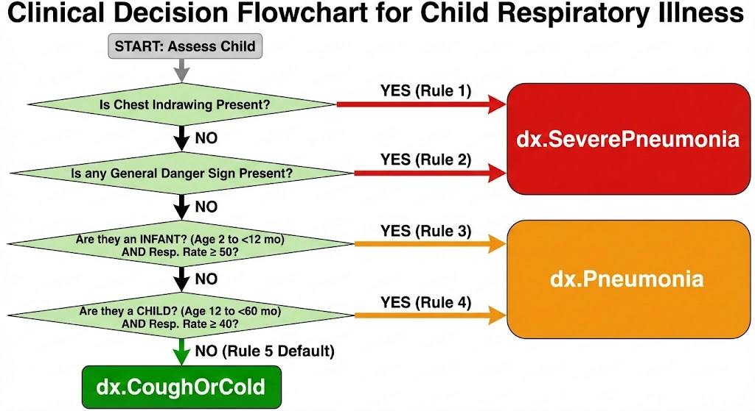
Notes:
Diagram by Gemini reading Mermaid.

Slide 15
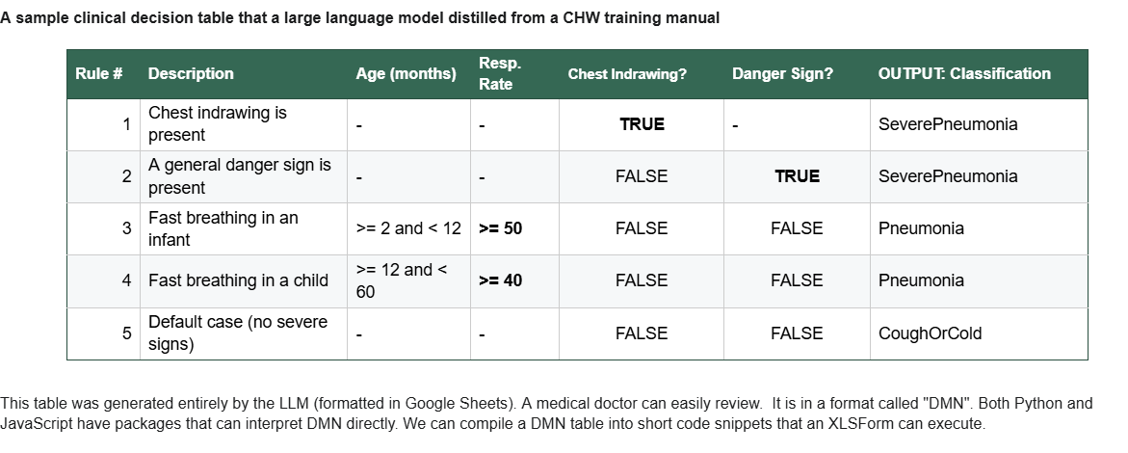
This "DMN" table for children with a cough was generated solely by an LLM
We can easily translate this table into the XLSForm that CHT uses
MDs can review tables like this one
And into a flowchart for clinicians to review
At end: set cough_mod_done = true and return to the traffic cop

Slide 16
For any module
Cough table asks about a combination of respiration rate and age
Implies: respiration rate & age are in the data before we get to this table
Turn continuous or categorical into true/false (Boolean or dummy) variables:
if age_mo < 12 then age_lt_12_mo = true (MD sees "Age < 12 months")
if rr_min >= 50 then rr_ge_50_min = true ("RR ≥ 50 / min.")
if rr_min >= 40 then rr_ge_40_min= true
For each measure, we handle missing data, as in:
if muac = missing then muac_missing = true

Slide 17
What inputs does each DMN require?
A DMN requires some boolean inputs.
Each boolean input requires (and implies)
1. A yes/no question or exam (e.g., Is there blood in stool?)
2. A yes/no data from the medical record (not yet implemented, and not a priority)
3. boolean, Categorical or continuous data from question, exam or medical record + some logic to create yes/no. (e.g., "Ask age in months or years") converts to age in months converts to age_le_12_mo or whatever.
So the one artifact created by the LLM is to draw out these implications and format them so the compiler can output the appropriate XLSForm.
For example: a cough diagnosis table might have inputs: p_age_2_59m p_fast_breathing p_chest_indrawing p_danger_sign
So implies logic
* p_age_2_59m = true if age_mo >= 2 & age_mo <=59
* p_fast_breathing = F( measurement of respiration rates / minute, age)
* p_danger_sign = true if any of a bunch of earlier observations or questions on convulsions, etc. are true
In turn, that logic implies data collection (if not already collected):
ask or find in medical record: age_mo
measurement of respiration rate
observation of chest indrawing
observation of all the general danger signs
One intermediate artifact is the source of each variable:
Some data are from the opening module: age_mo and observation of all the general danger signs. So no need to collect in later modules.
Some data may be collected only in one module, so always collect for that DMN
Some data may be already known if they went to a particular earlier module. So need to check "If temp_C = missing then ex_temp_C" where ex_temp_C is instructions to the CHW to take temperature.

Slide 18
There is a standard list of variable names
q.age_mo "What is you child's age (in months)?"
ex.temp_C "Use the thermometer to take temperature"
Many (but not all) are in the dictionary emett circulated.
You can add to that dictionary following the naming conventions.
Possible example of a fragment of a patient's data: {age_mo : 32, temp_C : 38.1, cough = True ,... }
Note: product, testing and medical teams should create the real format

Slide 19
SAMPLE Treatment table for Cough module
If the manual does not cover a stock-out, mention that fact
Diagnosis | CHW Has amox | Treatment | Dosing table
Pneumonia | True | tx_amox | dose_amox_pneumonia
Pneumonia | False | ALERT: Manual does not cover this case
SeverePneumonia | - | refer_clinic_today | N/A
coughCold | - | Go home and rest | N/A

Slide 20
Input | Type
age_months | number
diagnosis_pneumonia | boolean
danger_sign | boolean
chest_indrawing | boolean
Output | Type
amoxicillin_single_dose_mg | number
doses_per_day | number
treatment_days | number
tablets_250mg_per_dose | number

Slide 21
DMN Decision Table
Decision Name: amoxicillin_dose_pneumonia_child
Hit Policy: UNIQUE
Inputs
Outputs
DMN Table

Slide 22
Sample DMN dosing table: Metadata
Decision
Decision Name: amoxicillin_dose_pneumonia_child Hit Policy: UNIQUE
Outputs
Output | Type
tablets_250mg_per_dose | number
doses_per_day | number
treatment_days | number
Inputs
Input | Type | Description
age_months | number | Age in months

Slide 23
LLM generates and shares with testeing team: a table with conversions from continuous to boolean, such as: if age_mo <= 6 then age_le_6 _mo = true
Sample DMN dosing table
Fires if tx_amoxicillin= true
Rule | Age_le_6 _mo | tablets_250mg_per_dose | doses_per_day | treatment_days
1 | true | 1 | 2 | 5
2 | false | 2 | 2 | 5
3 | missing | …

Slide 24
Traffic cop 1: Add modules to queue (runs after every module)
Hit policy: Multiple hits allowed
Inputs: Start (boolean)+symptoms that trigger a module (such as Fever, etc.)+queue of modules
Output: Queue of modules
 | Start? | Has fever? | Has cough? | Has diarrhea? | Results
At start | yes | any | any | any | Add opening module + integrative module Set start = false
Fever | no | yes | any | any | Add fever module at end of queue, but before integrative
Cough | no | any | yes | any | Add cough module at end of queue, but before integrative
Diarrhea | no | any | any | yes | Add diarrhea module at end of queue, but before integrative
Else | no | no | no | no | End this decision table (unless at start, in which case see manual)

Slide 25
Traffic cop 1: Add modules to queue (runs after every module)
Hit policy: Multiple hits allowed Inputs: Start (boolean)+symptoms that trigger a module (such as Fever, etc.)+queue of modules Output: Queue of modules
 | Start? | Has fever? | Done fever module | Has cough? | Done diarrhea? | Has diarrhea? | Done diarrhea? | Results
At start | yes | any |  | any | any | any | any | Add opening module + integrative module Set start = false
Fever | no | yes | No | any | any | any | any | Add fever module at end of queue, but before integrative
Cough | no | any | any | yes | no | any | any | Add cough module at end of queue, but before integrative
Diarrhea | no | any | any | any | any | yes | no | Add diarrhea module at end of queue, but before integrative
Else | no | no | any | no | any | no | any | End this decision table (unless at start, in which case see manual)

Slide 26
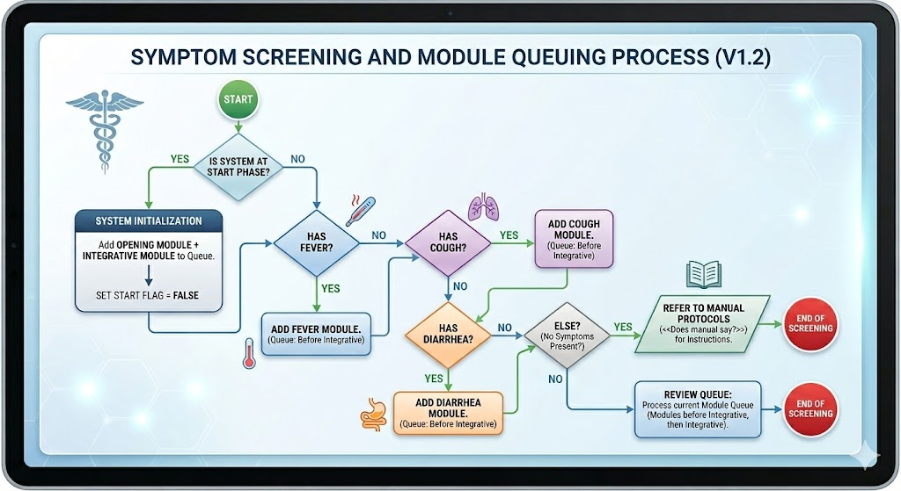
Traffic cop 1: Add modules to the queue. Gemini version of prior table

Slide 27
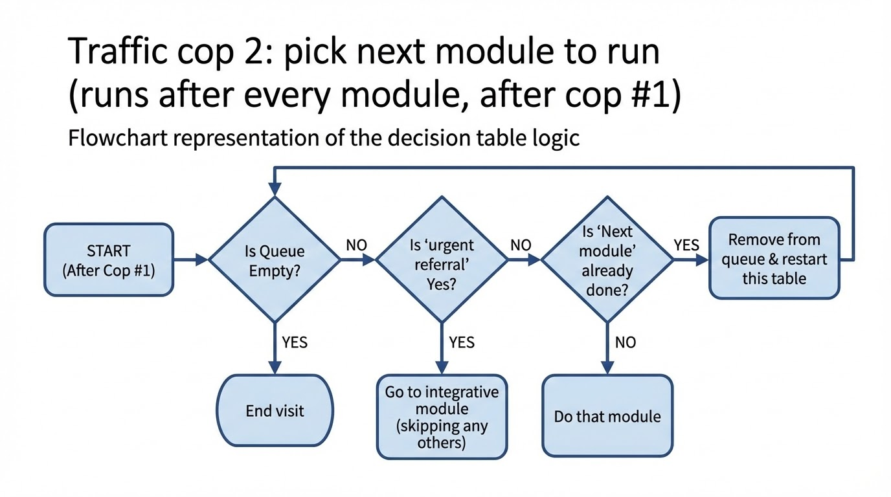
Gemini drew this flowchart based on the decision table

Slide 28
Translate all CHW-facing text
Two separate AIs translates all phrases into the requested languages, including the “How do I?” guidance for giving exams, providing treatments, etc. They
Avoid jargon
Use locally appropriate terms.
A third AI back-translates
A final AI reviews and improves the translations
The resulting phrase book is shared with clinicians and CHWs in a form that they can easily edit
The software uses only phrases that clinicians and CHWs have approved

Slide 29
Traffic cop:
Hit policy = mutually exclusive
Inputs = queue of modules + list of completed modules
Output = queue of modules + Done (boolean)+next module (e.g., starting module, fever, integrative)
 | Queue empty | Urgent referral | Next module already done? | Result
Visit done | Yes | Any | Any | End visit
Urgent referral | No | Yes | Any | Go to integrative module (skipping any others)
Next module in queue | No | No | Yes | Remove from queue & restart this table
Next module in queue | No | No | No | Do that module

Slide 30
Mermaid of cough DMN
%%{init: {'theme': 'base', 'themeVariables': { 'fontSize': '24px', 'fontFamily': 'Helvetica', 'primaryColor': '#fff', 'edgeLabelBackground':'#ffffff', 'tertiaryColor': '#f4f4f4'}}}%%
graph TD
%% --- STYLING DEFINITIONS ---
classDef questionNode fill:#d4edda,stroke:#28a745,stroke-width:3px,color:black,font-size:20px,font-weight:bold;
classDef severeOutcome fill:#dc3545,stroke:#721c24,stroke-width:4px,color:white,font-size:26px,font-weight:bold,rx:15,ry:15;
classDef pneumoniaOutcome fill:#fd7e14,stroke:#ba5e0f,stroke-width:4px,color:white,font-size:26px,font-weight:bold,rx:15,ry:15;
classDef mildOutcome fill:#28a745,stroke:#155724,stroke-width:4px,color:white,font-size:26px,font-weight:bold,rx:15,ry:15;
classDef startNode fill:#e2e6ea,stroke:#333,stroke-width:2px,font-size:20px;
linkStyle default font-size:20px, stroke-width:3px;
%% --- FLOWCHART LOGIC ---
Start(("START: Assess Child")):::startNode --> Q1
Q1{"Is Chest Indrawing<br>Present?"}:::questionNode
Q1 -- YES (Rule 1) --> Severe[dx.SeverePneumonia]:::severeOutcome
Q1 -- NO --> Q2
Q2{"Is any General<br>Danger Sign Present?"}:::questionNode
Q2 -- YES (Rule 2) --> Severe
Q2 -- NO --> Q3
Q3{"Are they an INFANT?<br>(Age 2 to <12 mo)<br>AND<br>Resp. Rate ≥ 50?"}:::questionNode
Q3 -- YES (Rule 3) --> Pneumonia[dx.Pneumonia]:::pneumoniaOutcome
Q3 -- NO --> Q4
Q4{"Are they a CHILD?<br>(Age 12 to <60 mo)<br>AND<br>Resp. Rate ≥ 40?"}:::questionNode
Q4 -- YES (Rule 4) --> Pneumonia
Q4 -- NO (Rule 5 Default) --> Mild[dx.CoughOrCold]:::mildOutcome
Notes:
Mermaid created by Germini. It drew the following diagram. XX note highlighted lines are "modern" Mermaid. The online tools worked best with those lines deleted.

Slide 31
Compile the clinical logic into executable code
For example, translate the clinical logic into XLSForm for CHT

Slide 32
But can we trust AI output?

Slide 33
The Verification Stack for Zero-Trust Engineering
Adversarial Extraction: "Red Teams" hunting for logic gaps at each step of creating the clinical logic and code
Human Sovereignty: Mandatory sign-offs of clinical logic & of translations
Traceability: Cryptographic links to source text
Formal Verification: Mathematical proofs of consistency, various quality standards
Differential Testing: Synthetic patient simulations show the final code replicates the doctor-approved clinical logic
Notes:
Visual Idea: A layer-cake diagram showing the 6 layers stacked up, supporting a "Deployment Ready" flag at the top

Slide 34
Adversarial extraction: "Red Teams" hunt for logic gaps at each step
Our pipeline uses LLMs to divide the manual into pieces and assembles the pieces into the clinical logic:
Read manual PDF into structured text file
Identify lists of supplies, decisions, possible diagnoses, possible treatments, etc.
Create decision tables with the clinical logic
Etc.
At each step, a separate AI has a "red team" prompt checking if each intermediate artifact is complete and hits is quality standards
A third AI adjudicates between the first output and the red team review (and cycles back to the red team, up to 3 times)

Slide 35
Sample quality standards for the red team
Consistency of DMN & its building blocks (unless clinicians approve an exception)
All diagnostic equipment and supplies and all treatments mentioned in the Supply list are used in a Decision table, and conversely
All variable names (symptoms, exams, drugs, etc.) are in the dictionary and the phrase book
Rules exist to convert all categorical and continuous variables into the true/false variables used by DMN
…

Slide 36
Sample quality standards for the red team
DMN decision tables
Every DMN decision row is reachable
Only true/false inputs
no FEEL arithmetic
no hidden calculations inside DMN
explicit ELSE row
explicit hit policy
outputs that are enumerated and reviewable
integrative logic separate from module-local logic when possible
XLSForm
Every rule in XLSForm matches the doctor-approved rule on boundary cases
Every output code in XLSForm has a corresponding DMN output value
etc.

Slide 37
Human Sovereignty & Impact
AI generates the draft clinical logic, but clinicians own the decision.
Mandatory Human Gates
Ambiguity Resolution: MOH must clarify manuals that the AI does not consider complete
e.g., “The manual does not define a rule if a stockout of…”
Logic Review: MOH clinicians approve the clinical logic presented in Plain English and Flowcharts (not code)
For updates, the system highlights where the update modifies the logic
Translation Sign-off: Local staff approve exact message wording
The Result: Code that is clinically credible and MOH-approved
Notes:
Visual Idea: A roadmap graphic with "Stop Signs" at key intervals labeled "MOH Sign-off," leading to a final green light.

Slide 38
Mathematical Proof of Consistency with Z3 prover
Use formal prover to show the decision rules have desirable properties
All paths end in a clinical diagnosis
No patients have mutually exclusive diagnoses or treatments
No cycles
Plans for all forms of stockouts
etc.

Slide 39
Sample quality standards: Universal rules
Unless the manual or a clinician overrides:
Adding a diagnosis, adding a general danger sign, or worsening a symptom (e.g., a higher fever)
Never reduces referral intensity
e.g., never replaces hospital referral with clinic or clinic with home care
Never lengthens time to follow-up
We also ensure usability: Maximum # of clicks and of screens

Slide 40
Security rules for XLSForm
“Forms SHALL NOT initiate network communication.”
Testing
Static scan of XLSForms for:
pulldata() with remote URLs
custom JS widget references

Slide 41
Traceability and Replicability
Traceability: Every rule and line of code is linked to a specific page and text snippet from the source manual(s)
Replicability: We cryptographically sign and freeze the clinical logic after MOH approval. All code and libraries that validate the clinical logic and then compile the logic into code such as XLSForm live in a single container with a unique hash.
Everything after clinical sign-off is deterministic (no AI), so is bit-by-bit replicable

Slide 42
z3 also generates thousands of Synthetic Patient Profiles.
All one-diagnosis cases & clinical endpoints
Comorbidities: Both common and rare combinations of symptoms
All two-diagnosis cases
critical three-way interactions
Generate Stress Tests:
Boundary Triples: Temp = 37.4°C, 37.5°C, 37.6°C.
Missingness: Handles broken instruments, stock-outs, skipped questions.

Slide 43
Compare output from doctor-approved DMN and XLSForm that runs on CHWs' phones
For each synthetic patient, compare:
Questions & exams
Diagnoses
Treatment including
Drugs
Dosing
Follow-up visit timing
Referral urgency
Stockout substitutions
Conflict resolution across diagnoses or treatments

Slide 44
After we compile the clinical logic into executable code
For example, for CHT the system translates the clinical logic into XLSForm
We verify that thousands of simulated patients have identical diagnosis and treatment when run through:
The decision logic the MOH approved
The flowchart made from that logic
The executable code (such as XLSForm) compiled from that logic

Slide 45
Input to Test harness
Decision tables
Predicate Table for converting continuous data from patient data (age, temperature, etc.) to boolean variables used in the DMN decision tables
infant_fast_breathing = (age_mo > 2) AND (age_mo <=12 mo) AND (resp_rate ≥ 50)
child_fast_breathing = (age_mo >12 mo) AND (resp_rate ≥ 40)

Slide 46
Differential Testing
Mutation testing: When we purposely modify any rules or patients, we require the system to identify 100% of such discrepancies
Notes:
Visual Idea: A "Diff" comparison chart. "Reference Model Output" on the left, "Mobile App Output" on the right. A big green checkmark in the middle showing "100% Match."

Slide 47
Quality checks: Reliability
Test-retest reliability: Give same manual and get clinically identical output
Inter-rater reliability: Use different LLMs for different tasks and get clinically identical output
Note:
Reliability does not prove validity,
but failure of reliability proves at least one run is wrong

Slide 48
Quality checks
Humans use the system to ensure
Sensible logic flow
Clear language
Reasonable # of clicks and of screens
etc.

Slide 49
Validation of this method
(planned)

Slide 50
Validation of our pipeline against independent oracles
Legacy Replication: Our pipeline leads to identical clinical decisions as existing hard-coded CHW software derived from a manual
WHO Gold Standard: For three WHO CHW manuals, we hand-coded decision tables and had MDs verify each rule. Our system’s decision logic reproduced the MD-approved rules.
Stress tests with synthetic adversarial manuals: We created complex synthetic manuals with known ground truth.
The system reproduces the known correct behavior.
When we input incomplete or internally inconsistent manuals, the system correctly identifies the issues

Slide 51
Field evidence #1: CHWs & Artificial patients
Recruit CHWs for a weekend
Give synthetic (artificial) patients
Compare adherence to guidelines with and without CHW Navigator
Note: Adherence will be artificially high in both conditions

Slide 52
Field evidence #2: CHWs & real patients with MD oversight
CHWs treat real patients with a nurse or doctor watching to ensure no harms
Compare adherence to guidelines with and without CHW Navigator
Note: Adherence will be artificially high in both conditions

Slide 53
Innovation Summary
Summary:
From: Manual Transcription To: Verified Compilation.
From: "Black Box" Logic To: Traceable Provenance.
From: Post-Deployment Debugging To: Pre-Deployment Clinical review+ Mathematical Proof.
Final Impact: A generalizable framework for producing auditable, reproducible, and trustworthy decision support in low-resource settings.
Notes:
Visual Idea: A simple "Before vs. After" comparison table summarizing the points above.

